Slide 1
EMPLOYEE ATTRITION ANALYSIS
BY
FIZA FAHAMEEN M
Insights from Employee Attrition Data

Slide 2
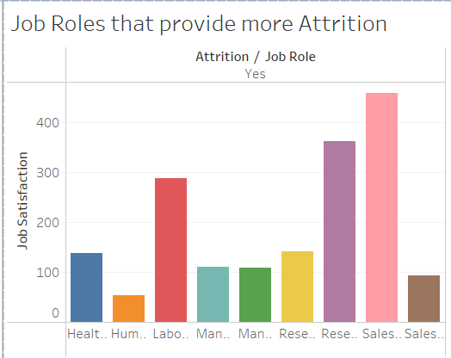
According to the Category Wise Analysis
Sales Sector has the most highest Attrition Rate.
The Human Resource are the least worried about Job Satisfaction
ATTRITION BASED ON THE ROLE OF SERVICE IN COMPANY

Slide 3
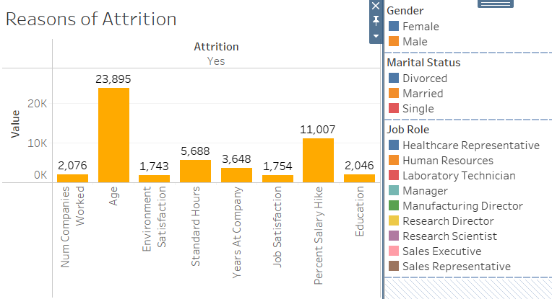
The Following are the Various Reasons of Attrition.
AGE
SALARY HIKE
HOURS OF WORK
Are the three calculated measure which are the condition that effect the Company.
Experience and Enviironment Satisfaction are other reasons to stand out.

Slide 4
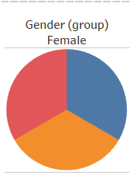
WOMEN IN WORK AREA
BLUE DENOTES:
DIVORCED
ORANGE DENOTES:
MARRIED
RED DENOTES:
SINGLE

Slide 5
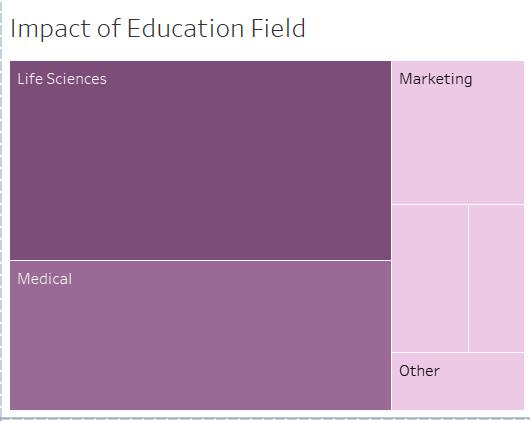
IMPACT OF EDUCATIONAL FIELD:
People belonging to Life Science and Medical have high chances to opt out of Company

Slide 6
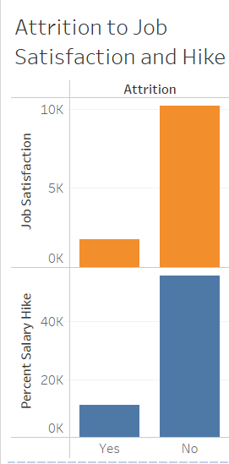
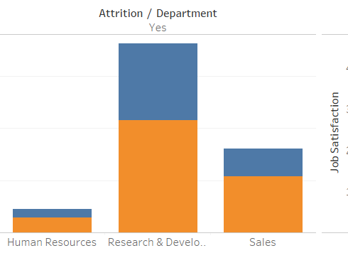
The Blue denotes Female Employees
Compared to Orange of a Male.
MALE Employees tend to shift from one job to another more due to salary hike and satisfaction of Job.
Providing gradual Salary Hike can be implemented.

Slide 7
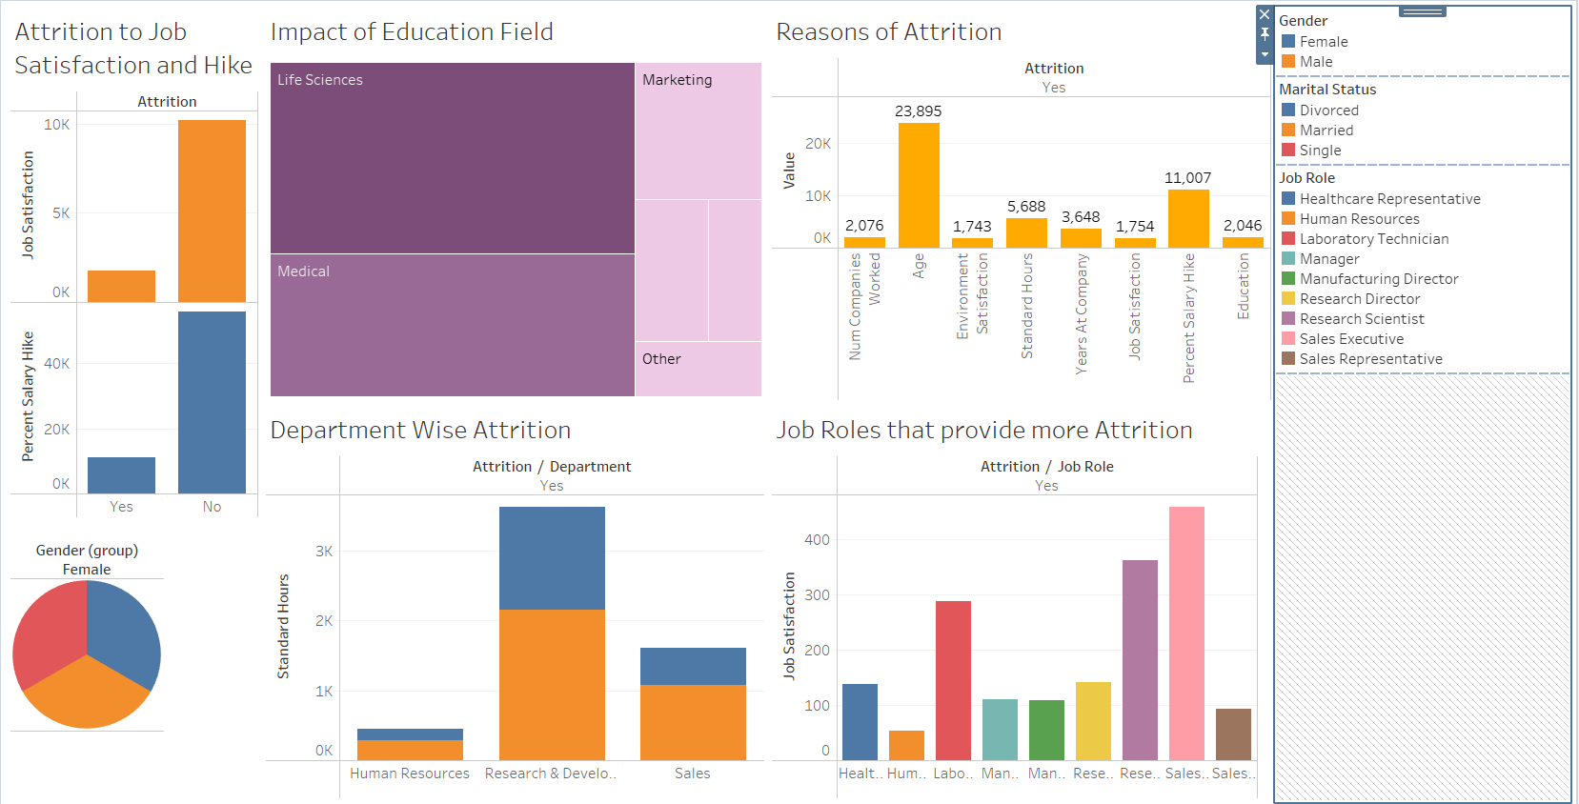
TABLEAU INSIGHTS

Slide 8
Thanks!
fizafahameen@gmail.com
Fiza Fahameen M

